Slide 1

EYFS Parent Induction Meeting
www.fourmarksprimary.co.uk

Slide 2
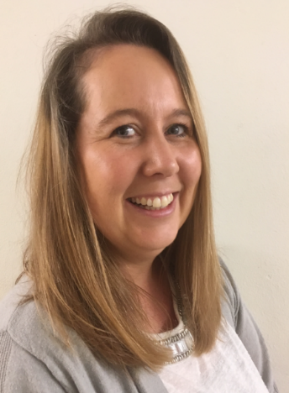
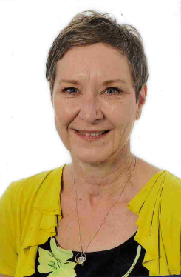
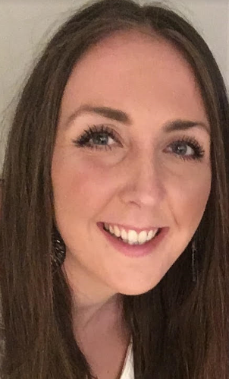

Meet our Reception Team!
Early Years Holly and Chestnut Classes
Miss Esther Andrews
Holly Class Teacher
Early Years Lead
Miss Gemma Humphrey
Chestnut Class Teacher
Mrs Sarah DuLam
Holly Class Learning Support Assistant
Mrs Lisa Jones
Chestnut Class Learning Support Assistant
Notes:
Veronica- Introduce team.
Miss A- going into fourth year at FMPS.
Miss Humphrey- Joining us this year with an extensive background in early years education.
Mrs DuLam- very experienced EYFS practitioner in both preschool and school settings
Mrs Jones- Has been in year R here at FMPS for 20 years!

Slide 3
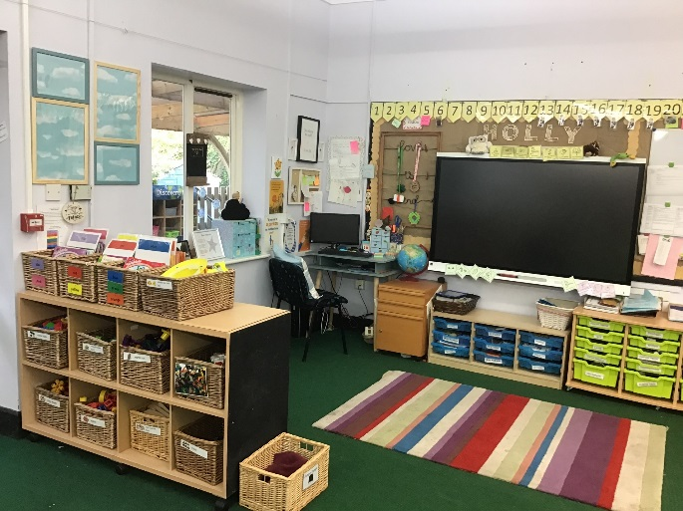
Our Set up
2 small classes (approx. 20 children in each)
An outdoor area which links the two. This will be redesigned over the summer.
Children ‘free flow’ between the two classrooms and the outdoor area.
Notes:
ESTHER
We are very lucky to have small classes this year ☺
We have two classrooms which are purpose built and designed for early years.
Our outdoor area is having some much needed TLC this summer and has been completely redesigned as a purposeful learning space.
The children flow between the two classrooms and outside.

Slide 4
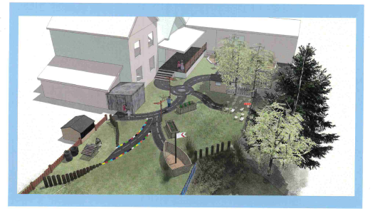
Plans for the outdoor area
Notes:
ESTHER
Our new outdoor area has been designed and created by a very talented and generous parent and will be ready for your child to start in September.
We will be replacing the concrete paving slabs with a mixture of AstroTurf (in areas with little sunlight to prevent too much mud!) and real turf where we can get away with it!
The new garden will provide ample opportunities for outdoor construction, writing, role play, music, sand and water play, as well as some raised beds for our children to grow their own herbs and vegetables.
We have kept the wooded area totally unchanged. It was very important to us that the children still have the opportunity to explore a more ‘wild’ area, they absolutely love climbing in the trees and spotting the wildlife!

Slide 5

Transition
We work hard to ensure this is as smooth as possible for the children.
We have already visited all children in their preschool settings and had professional discussions with their key workers.
The children come for four visits, 2 with parents and 2 without. On the final visit children can stay for a hot lunch. This costs £2.15 per child. Please return the slip in your pack. We also have a teddy bear’s picnic, which is a more informal event for families to get to know each other.
All children will have a home visit in September.
Notes:
ESTHER
We have already met all the children in their preschool settings. This is an invaluable aspect of the transition process as it gives us the chance to watch the children in a setting where they are already comfortable, and to chat with the adults who in some cases have had them since babyhood!
We have already had the first visit which hopefully gave you a chance to have an explore. Although Miss Humphrey unfortunately cannot be at the visits due to her ongoing commitment with her current workplace, she is available for you to chat to tonight, and will also be at the Teddy Bear’s Picnic.
The other three of us will be available at all transition events, and will be supported by Mrs Sarah Telford, who is often supporting us in year R and will become very familiar to the children.
We encourage all chn to be full time as soon as possible, chn settle in quicker, make friendships, get used to routines etc.
Flexible approach- You may start with children coming in full time and then decided that this isn’t working for you child and decided to drop a few sessions, it is completely up to you and what your child is happy with doing. This will be discussed during your home visit in September. Home visit letters will go out in June ready for September. If your time/day does not suit you please let us know and we can rearrange

Slide 6
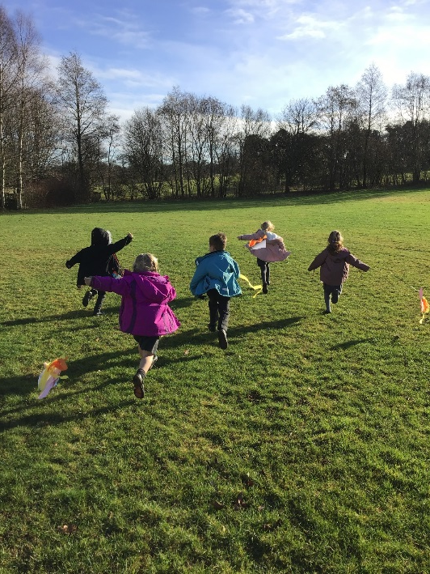
Our Curriculum
EYFS does not come under the National Curriculum
We follow ‘Development Matters’ a government recommended document which splits children’s early learning into 7 areas:
    Personal, Social and Emotional Development
    Communication and Language
    Physical Development
    Mathematics
    Literacy
    Expressive Art and Design
    Understanding the World
Notes:
GEMMA
The Early Years Foundation Stage is not covered in the statutory National Curriculum.
We follow Development Matters, which is used by most settings. This Document presents the ‘expected’ stages of development across seven areas of learning. We work towards children reaching the ‘Early Learning Goal’ in each of these areas.
Our curriculum is skills based and tailored to children’s personalities and interests. We follow lines of enquiry with the children, and encourage their natural curiosity about the world around them.
We also teach fundamental skills. We do phonics and maths daily. Initially these sessions are only ten minutes long, but will develop over the year until children are able to focus for longer in the summer term, ready for year one.

Slide 7
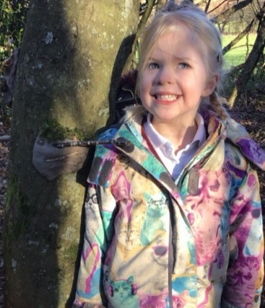
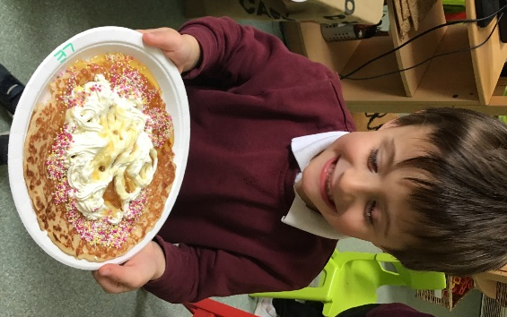
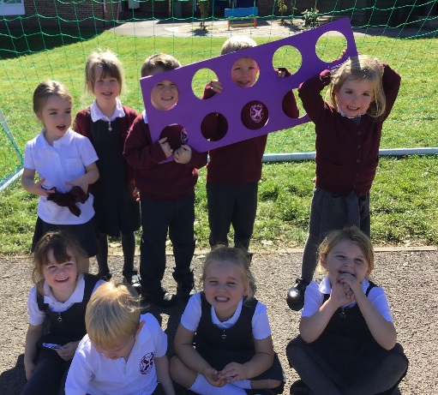
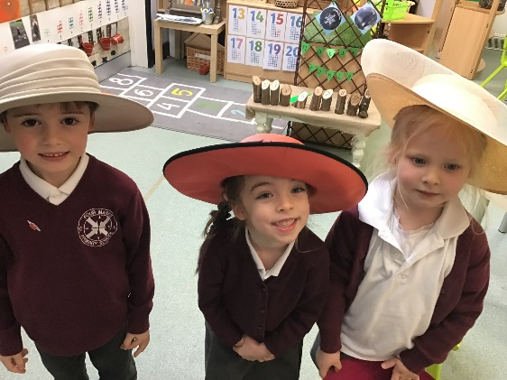
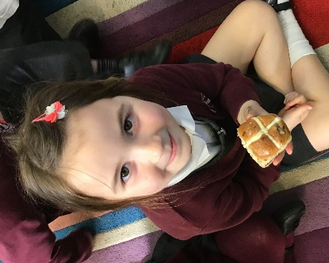
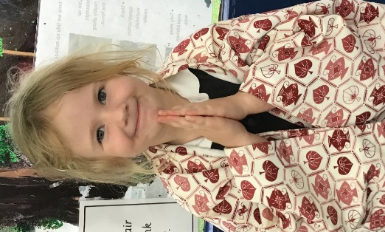
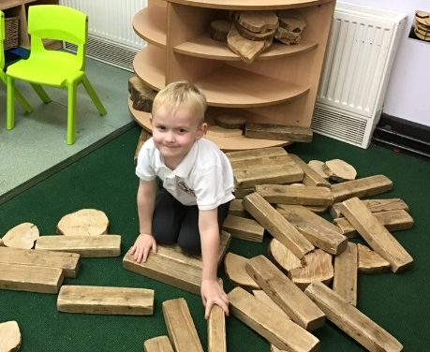
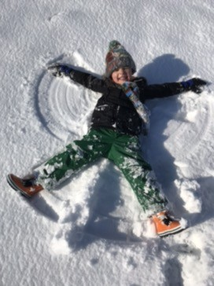
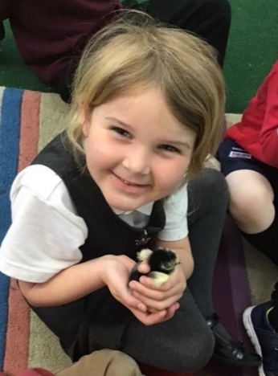
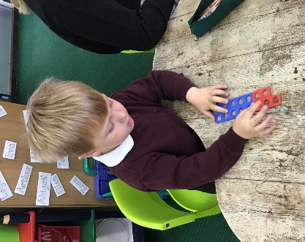
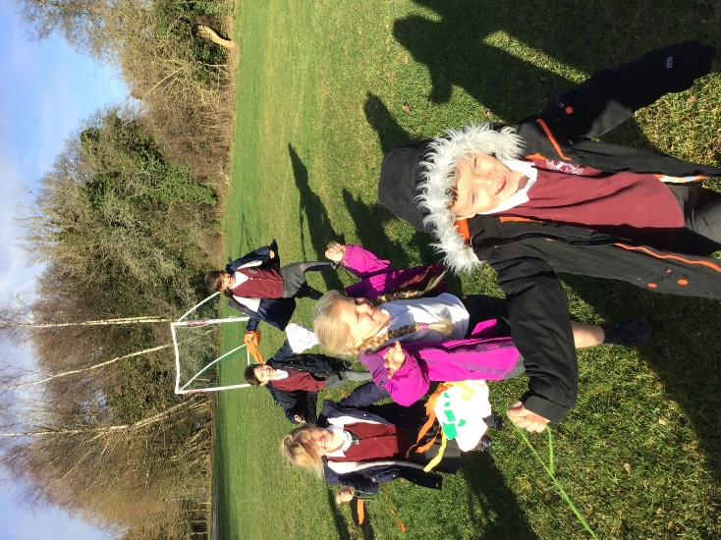
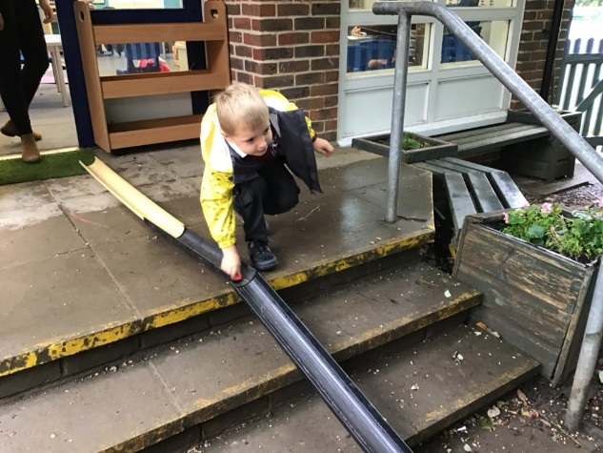
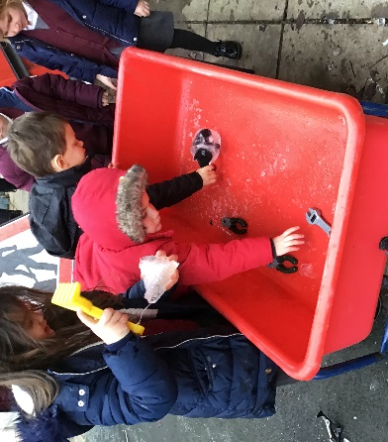
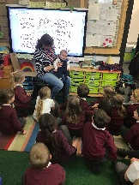
Some examples of interest-led learning
Notes:
ESTHER
We follow children’s interests to wherever they take us! We believe that learning is far more effective when children have a personal involvement.
An example of this happened earlier this year when one of our children declared ‘I am going to make a kite today!’ This was totally not what we had planned, but we went with it, and before too long all our children were making kites! We flew them on the field and talked about which shapes flew best, larger kites vs smaller kites, air resistance etc!
The children were totally engrossed and engaged as the idea had come from them.

Slide 8

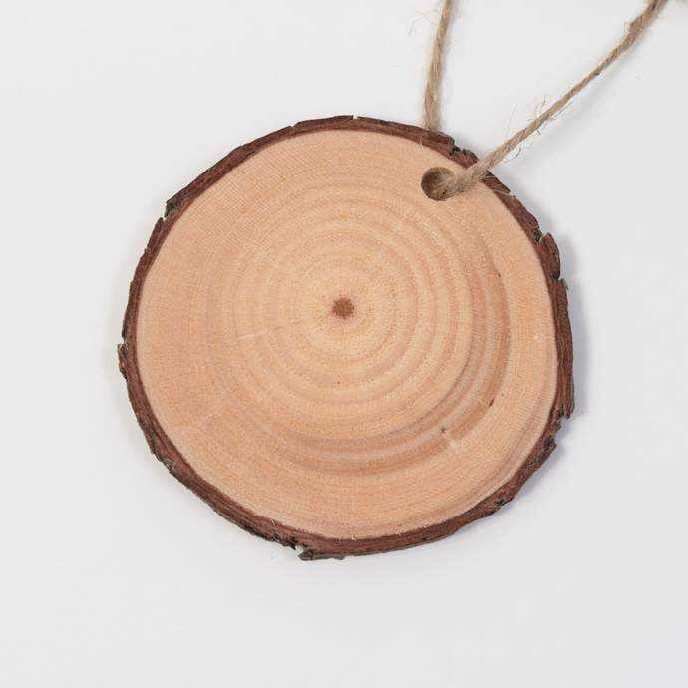
Learning Spaces
Designed exclusively for the children.
Personalised learning spaces, and the children feel a sense of ownership over their classroom. We fill them with pictures and objects that are meaningful to our children
Neutral and not over stimulating
Authentic resources that spark curiosity!
Notes:
ESTHER
We design our classrooms specifically for children and not for adults. This sounds very obvious but is actually more complex than you would think! Everything in our classrooms and outdoors is there for a reason.
We believe our children’s learning space should be as personalised to them as possible. You will notice that each child has a space on the wall with a family photo/s. They also have their picture on the class alphabet. These are up before they start school so that on that first daunting day they have some ownership of their space already and the family photo has proved to be very comforting for some. Please send these to Mrs Ballard - email address is on the back of your welcome pack.
We have been moving away from over stimulating bright colours on our walls. You will notice that we try to have children’s work be the brightest thing in our learning space!
We have replaced a lot of our brightly coloured plastic toys with more open ended resources that develop children’s imagination. A plastic tomato can only be a tomato, but a wooden round such as this one can be a million different things in the eyes of a child! We are always on the look out for interesting objects that cause children to ask ‘What is it?’ ‘Who did it belong to?’ etc. These kind of resources create endless discussion and wonder.

Slide 9
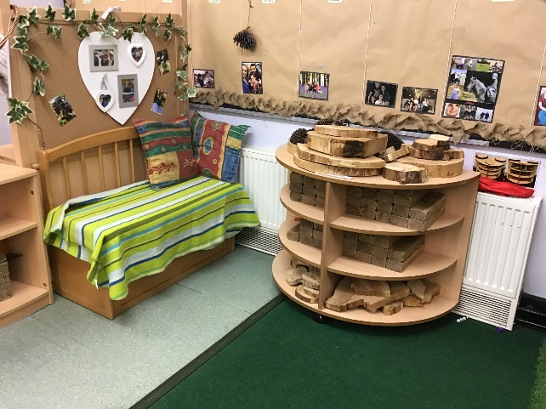
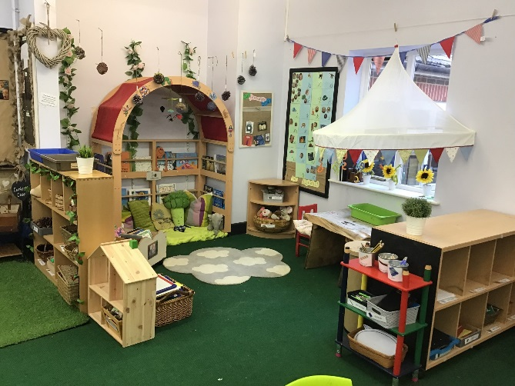
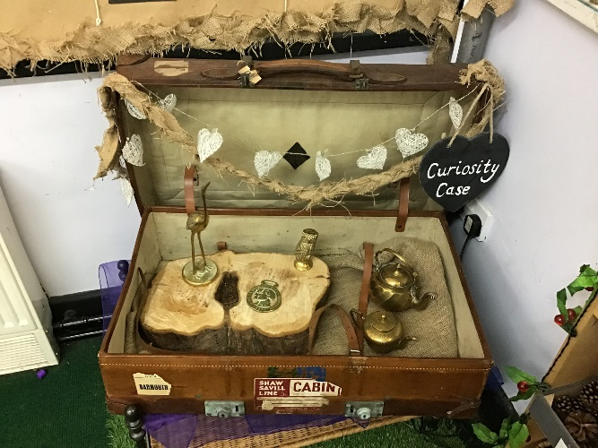
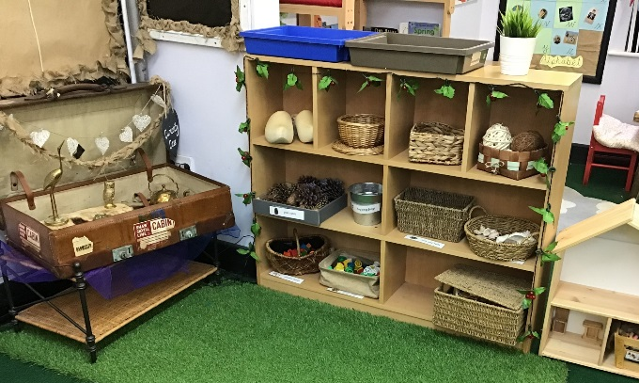
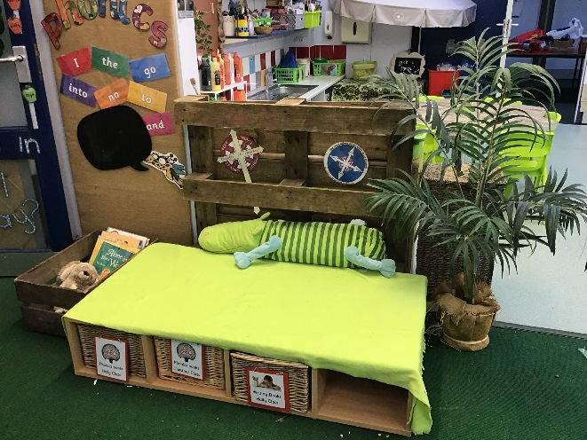
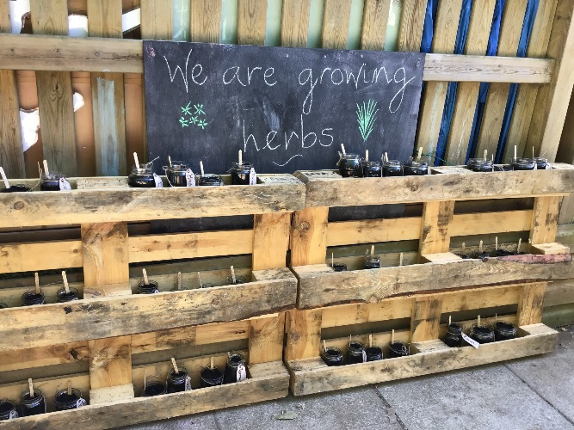
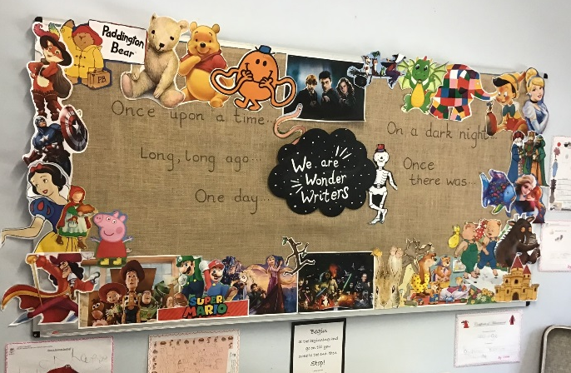
Some images of our classrooms
Notes:
ESTHER
Here our some images of our learning environment. As you can see we try to find a balance between classrooms which are neutral but also exciting and engaging.

Slide 10
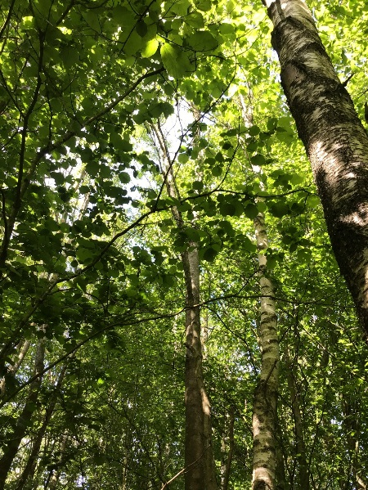
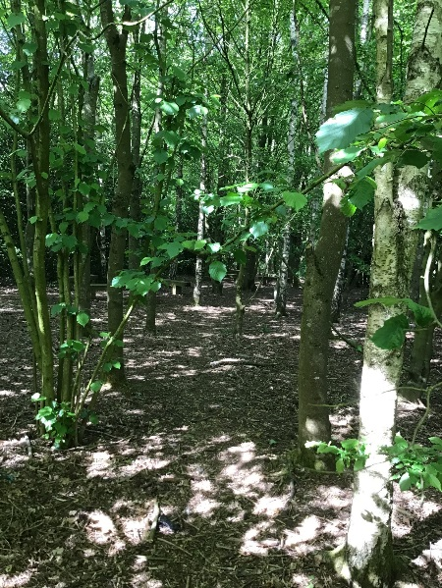
Forest School
Miss Andrews is a Level 3 Forest School leader, trained with the Hampshire and Isle of Wight Wildlife trust.
Forest School allows children to explore nature and learn basic skills such as simple tool use and cooking over a fire.
Our children will be having Forest School sessions at least weekly in all weathers!
Please ensure your child is sent in with adequate clothing, including a waterproof coat, and ideally waterproof trousers.
More info is available at: www.forestschoolassociation.org/
Notes:
ESTHER
I am very excited to say that by the time your children start in September I will be a fully qualified Forest School leader.
I have been working towards this all year, and have thoroughly enjoyed my training.
There will be an information evening for you in the new academic year to go into this in more detail and give you the chance to look over our Forest School handbook which contains all the necessary information and risk assessments.
We have an incredible site and I can’t wait to make full use of it!
Please ensure your child comes properly equipped for forest school, they will need a waterproof coat and waterproof trousers. They mustn’t be anything that matters as they will be getting muddy!

Slide 11
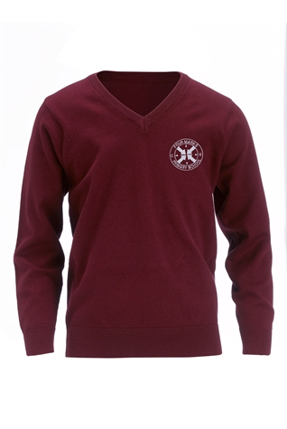

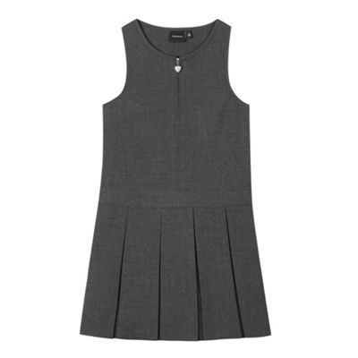

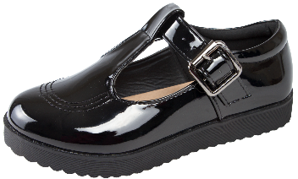
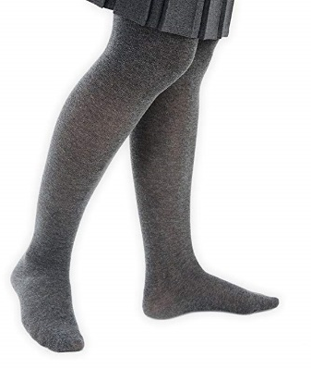

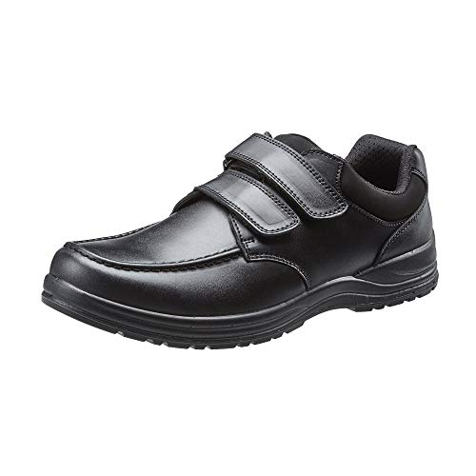
Uniform
Winter Uniform
Notes:
GEMMA
Speaking of clothing- school uniform!
Polo shirt (available with the logo- but it doesn’t have to have one!)
Grey trousers
Grey socks and black school shoes
A maroon school jumper (available with the logo again- info is in the packs!)
Or
Polo shirt with grey pinafore dress, grey tights and a maroon cardigan.
Durable and study school shoes!
Obviously they will need a warm coat in winter as they spend a lot of time outside. They will also need hats, scarves and gloves when it gets really cold.

Slide 12
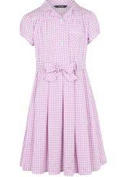


Uniform ctd.
Summer Uniform
Notes:
GEMMA
In the summer children can wear a white polo shirt with grey shorts, or a pink chequered summer dress. When it gets very hot they will also need sunhats and possibly sun cream. FMPS logo sun caps are available, or they can bring in their own- but do ensure it is named.

Slide 13
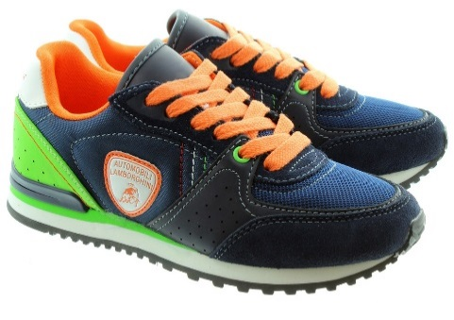
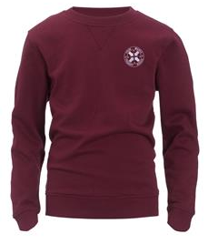


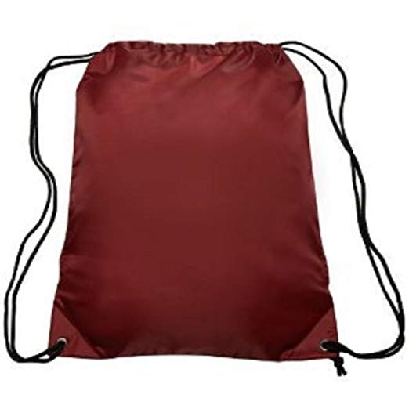
Uniform ctd.
P.E Kit
Notes:
GEMMA
Children have P.E. lessons twice weekly. One of these is a session lead by professional sports coaches.
They will need to have a P.E. kit in school containing:
A white polo shirt
Black shorts
A P.E jumper (logos are available)
Jogging bottoms (for when it is cold)
Trainers (they tend to last better than plimsolls)
From the first week the children will be changing by themselves as much as possible (although we will of course be around to help and support them). Changing in and out of school uniform and P.E. kit etc would be a brilliant thing to practice during the summer.
As I’m sure you can appreciate, it can be a bit of a mess when 20 children change clothes in the same room! Especially when they are all wearing the same uniform! For that reason it is ESSENTIAL that everything that comes into school with your child is clearly named. I would recommend iron on or sewn on labels, as names written in with pen are often totally illegible by Christmas!

Slide 14
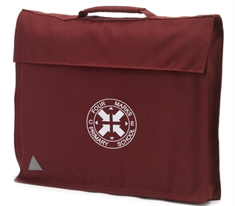
Book bags
Our PTA (parent- teacher association) kindly fund the book bags for the children, so you do not need to buy one.
We will bring your child their book bag on the home visit.
Like everything, it will need to be named, and will need to be in school every day.
Notes:
GEMMA
When we come for your home visit we will bring a book bag for your child so you do not need to purchase these. The children need to bring their reading book and red reading record to school every day in their book bad. Parents and teachers will write in these and record how many ‘reads’ a child has done in a year- these can be books they read or someone else reads to them.
Children can earn special silver ‘story wings’ badges when they reach 150 and 300 reads in a year. We don’t set formal homework in reception but encourage you to read with your child as much as possible. Your child will be read with weekly by a member of the team but it’s no exaggeration to say that there is a wide progress gap between children who are read with regularly at home and children who aren’t.

Slide 15

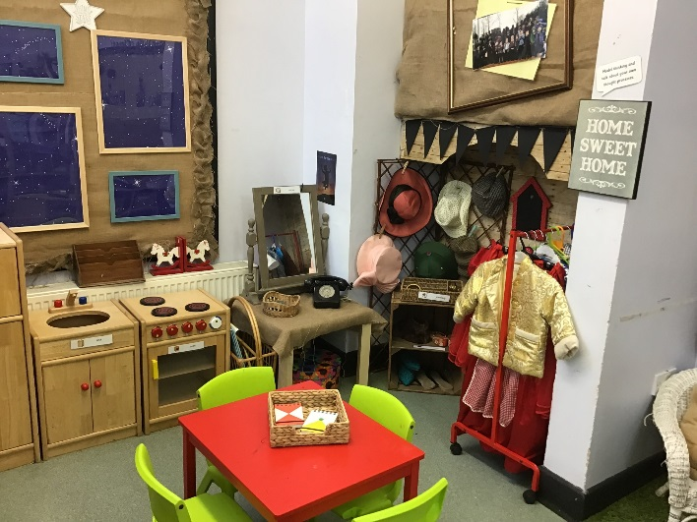
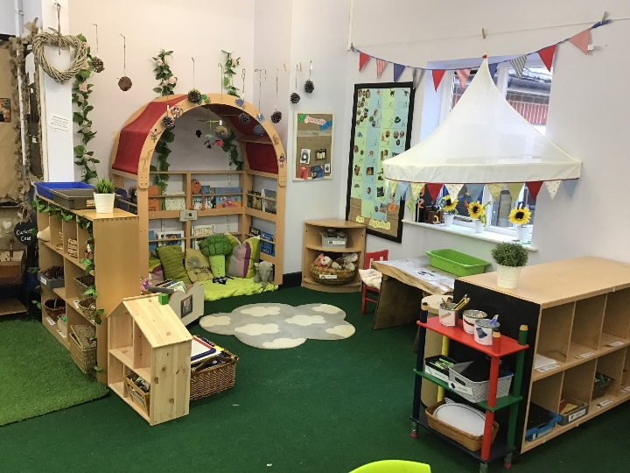
Our School Day
8:45-9:00 | Welcome and Registration
9:00-9:15 | Phonics
9:15-10:15 | Exploring & Learning
10:15-10:30 | Break time
10:30-10:45 | Whizzy Maths
10:45-11:45 | Exploring & Learning
11:45-1:00 | Lunch time
1:00-1:20 | Registration and quiet reading
1:20-3:00 | Exploring & Learning
3:00-3:15 | Story and Home time
Notes:
ESTHER
This is an example of a typical school day in the first term. As the year progresses, the children will have longer sessions of maths and phonics, and being to partake in different lessons such as drama, dance and R.E. There will also be some days when they will have P.E with the sports coaches, or Forest School.
In the morning the gates to the bottom playground open at 8:35. You will need to bring your child round to our EY outdoor area for 8:45 when we will open the classroom doors.
For the first couple of weeks we will welcome you to come into the classroom with your child and help them to put their things away and settle. After this time has passed, we will expect them to say goodbye at the door and come in independently. We will be able to support you if your child, or indeed you are finding this difficult.
The children have large chunks of ‘Exploring & Learning’ time. These sessions are when we will put out exciting activities for the children, and they are allowed to freely choose where they go in the environment (inside and out) and play with the resources we have available. We use this time to play with them, get to know them, and take observations of them learning through play. We upload these onto Tapestry, an online learning journal. We will be having an information evening about Tapestry early in the Autumn term for those of you haven’t used it before.

Slide 16
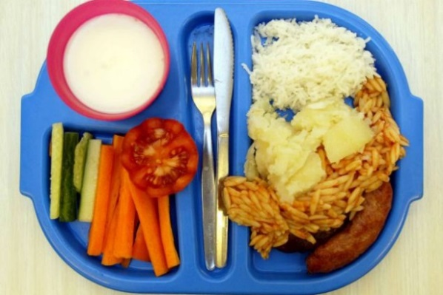
School Lunches
All children in year R and Key Stage 1 are entitled to free school meals
The lunch menu is on a three weekly rota
There is always a vegetarian option, salads and puddings
Children choose what they would like during morning registration
Dietary requirements are catered for
Fruit is provided as a snack throughout the day
Children can bring in a named water bottle
Notes:
ESTHER
School lunches are free for all children in reception.
The menu works on a 3 week rota and there is always a vegetarian option. Children order lunches in the morning so they always get something they like. Children also have choice of salads items and puddings.
Gillian has a variety of foods for you to try this evening, so please feel free to have a taste!
If children have dietary requirements Gillian can accommodate for these.
You might be sitting there thinking you child is a fussy eater, we have lots of children at the beginning of the year that don’t eat anything – now eat everything.
Children can bring in a lunch box from home if preferred. We don’t allow them to have sweets or fizzy drinks in these. They don’t need a huge amount of food- a guideline would be how much they can eat in around 20 mins. There are some ideas for healthy lunchbox ideas on our school website.
We have snack time at school where children have a selection of fruit to choose from and the option of milk. Children can bring a NAMED water bottle into school, which they can drink throughout the day.
In line with our healthy schools policy we do not allow children to bring in bags of sweets for all the children in their class on birthdays. Each class has a special birthday box and when it’s someone’s birthday that child gets a treat just for them.

Slide 17

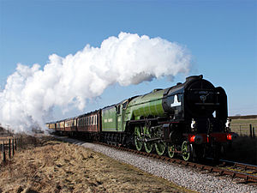
Extra Curricular
KOOSA Kids run breakfast and afterschool clubs daily.
There is a judo club in the hall run by ‘Jason’s Judo’
Street dance club after school on a Thursday
Private music lessons available within the school day
Trips
Pantomime
Watercress Line
Manor Farm Country Park
£48 for the year covers all trips. Alternatively they can be settled on a pay-as-you-go basis.
Notes:
ESTHER
We have breakfast and after school clubs run by KOOSA. Children have to be booked online through the KOOSA website- information is available in your pack
Mrs Jones runs the breakfast club- so the children will have a familiar face there ☺
Children go on different trips throughout the year and also have special visitors to school. We ask for a voluntary contribution of £48 per child per year, which will cover these activities. Alternatively you can pay for trips as you go.
These are the trips we have done/have yet to do this year. The money has also paid for our children to have a christmas party, a pancake party, and do food tasting

Slide 18
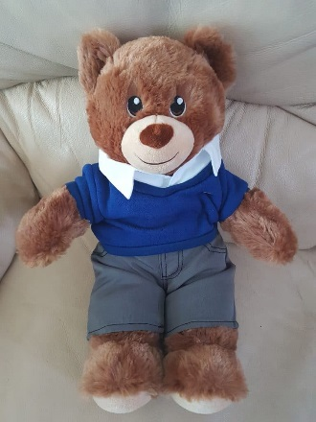
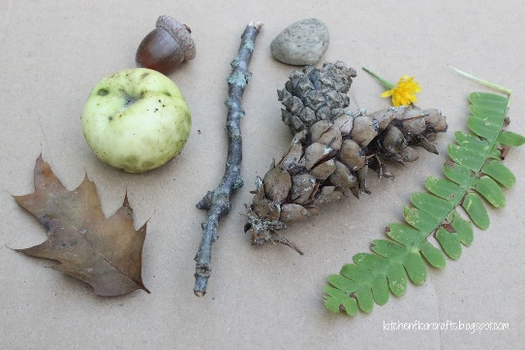
Extras ☺
Each class has a bear which goes home with a different child weekly. He has a scrapbook for you to record all the fun things you got up to!
Golden time is on a Friday afternoon. Children can bring in one toy from home.
We love interesting things for children to show and talk about, especially natural objects for our nature table.
Notes:
GEMMA
Each class has a class bear who comes home with a different child each week. The bear has a scrapbook for you to add photos of all the fun things you get up to. Please bear in mind that the book will be going to each child’s home so please don’t include photos you aren’t happy for other people to see.
On Friday afternoons the children have a ‘Golden Time’ session where they are allowed to bring in a toy from home to play with. We ask that these aren’t anything too large or too precious as things do get lost/broken with so many children around.
We do encourage children to bring in interesting things to talk about with their friends, especially things for our nature table. Last year we had an old wasps nest which caused endless fascination!

Slide 19
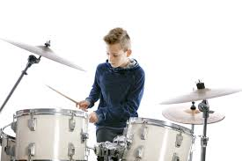
Pupil Premium Funding
Funding provided by the government
Each family is assessed and may be eligible depending on the household income
Children who qualify will always receive free school meals (beyond KS1)
Makes a huge difference to our school budget by allowing us to provide specialist staff training and resources
PP money can even be used to pay for enrichments- such as music lessons.
Notes:
ESTHER
As we have mentioned, all children automatically receive free school meals until the end of KS1- Unless the government decides to change this!
Some children are eligible to continue receiving free school meals throughout their time at school, depending on household income. If you think your child may qualify for this please let us know.
Even though they are getting free school meals in year R anyway the money we are given per eligible child each year they are at school is a huge boost to our school budget and allows us to support our children in lots of areas such as specialist staff training, resources and enrichment activities.

Slide 20

School Readiness
A ready child is:
excited and enthusiastic
Active every day
Happy to talk about their interests
Willing to try new things
Able to make choices
Beginning to accept the needs of others.
Able to concentrate on something they are interested on for short period of time
Able to communicate their feelings and listen for a short period of time
Notes:
GEMMA
Hampshire Local Education Authority have created this ‘School Readiness’ Leaflet, a copy of which will be in your packs.
It describes how you know your child is ready for school (READ SLIDE)

Slide 21

School Readiness ctd.
A ready family will:
Spend lots of time playing with their child
Encourage their child to communicate their feelings and emotions
Encourage self help skills (getting dressed, using a knife and fork, going to the toilet independently)
Establish and maintain consistent daily routines (bedtimes and mealtimes)
Share stories with their child
Have lots of fun with their child and discover new things together!
Academic preparation:
No academic expectation of what children ‘should’ be able to do in terms of maths or phonics
However…
If your child is showing interest, you could practice counting objects/movements, singing number songs and nursery rhymes and writing their name.
Notes:
GEMMA
There are things you can do to encourage these sorts of behaviours from your child. (READ SLIDE)
If your child is already writing their name, please ensure they are forming letters correctly and using a capital letter so they do not get into bad habits.
The welcome pack also contains a toileting questionnaire. If your child is currently not toileting independently we encourage you to try as much as possible to get them trained up over the summer. Of course all children develop at different rates so please fill in and return the questionnaire to give us as much information as possible so that we can best support you and your child.

Slide 22

Home-School Communication
Member of staff on Early Years door daily – communication book
Child’s Reading Record – checked every day
Appointments
Email school office
Telephone – 01962 772200
Email service
Please ensure school has your up to date contact details
Paperless school – check newsletter on website for regular dates
Notes:
GEMMA
In early years, we view our children in a holistic manner, which means it is important to know what’s going on in all aspects of their lives. Please always feel free to come and chat to us about anything. We are always on the door in the mornings and at the end of the day, or you can set up a more formal appointment should you need to.

Slide 23
Parental Engagement
Autumn Term Events
Weekly newsletter- received by email
Parent evening workshop on Phonics
Autumn term coffee morning
Parent evening workshop on Tapestry
Parent evening workshop on early maths skills
Parents information evening about Forest School
Parent’s Evening
Nativity play
Notes:
ESTHER
We have a weekly newsletter that you will receive by email. Make sure you check it out, especially the dates for the diary section! We will have lots of events going on for parents to get involved in, and would love to see as many of you as possible.
We would also encourage you to get to know one another and share contact details so that you can arrange events over the summer for the children (and yourselves!) to get to know each other. With that said, I will hand over to Charlotte Bloomfield. Charlotte is one of our parents from the current cohort of reception children, and is also one of our governors.
Thank you for listening. There will be time for you to ask any questions when you come into the classrooms shortly.

