Slide 1

Parents induction evening 2026-2027
www.fourmarksprimary.co.uk

Slide 2
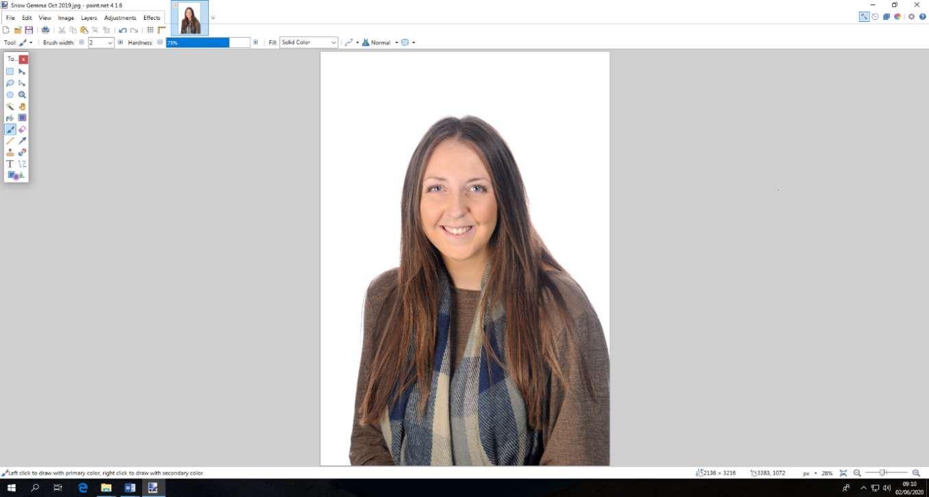
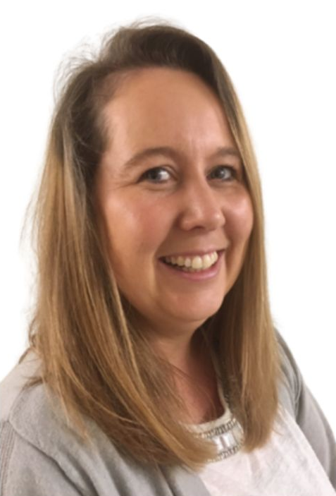
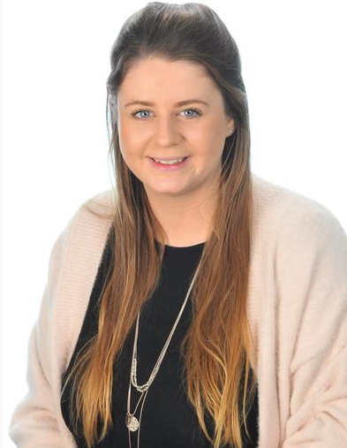
Meet our
Reception Team
Mrs Gemma Snow
Chestnut Class Teacher
Early Years Lead
Mrs Sarah Dulam
Chestnut Class Learning Support
Mrs Katharine Meager
Holly Class
Teacher
Miss Tierney Perkins
Holly Class
Learning Support
Notes:
ESTHER
Miss A- going into 10th year at FMPS. EYFS lead for 7 years.
Mrs Snow- Returning from Mat leave after being in EY at Four Marks for 4 years. So excited to have her back!
Mrs DuLam- extensive experience in EYFS here at Four Marks and in Preschool settings.
Mrs Burgess- new to our team with an extensive background in preschool settings, and experience in our school as part of our wraparound care team.

Slide 3
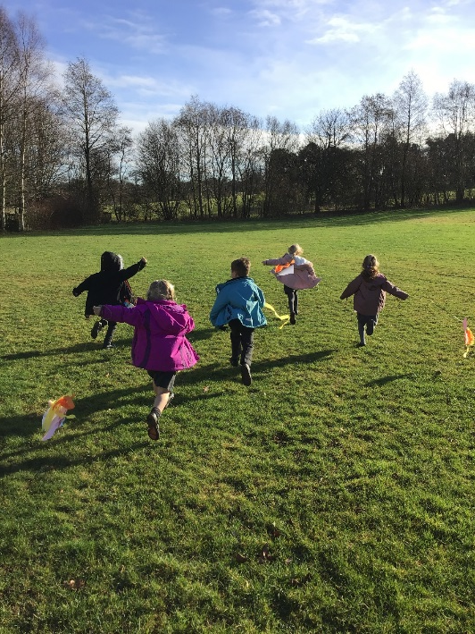
Our Curriculum
The Reception year is part of the EYFS which does not come under the National Curriculum.
We follow ‘Development Matters’ a government recommended document which splits children’s early learning into 7 areas:
    Personal, Social and Emotional Development
    Communication and Language
    Physical Development
    Mathematics
    Literacy
    Expressive Art and Design
    Understanding the World
Notes:
Esther
The Early Years Foundation Stage is not covered in the statutory National Curriculum.
We have built our curriculum around 7 different areas of learning, which enable us to see our children more holistically. At the end of the reception year, we work towards children meeting an ‘Early Learning Goal’ in each area.
Our curriculum is skills based and tailored to children’s personalities and interests. We follow lines of enquiry with the children, and encourage their natural curiosity about the world around them.
We also teach fundamental skills. We do phonics and maths daily. Initially these sessions are only ten/15 minutes long, but will develop over the year until children are able to focus for longer in the summer term, ready for year one.

Slide 4
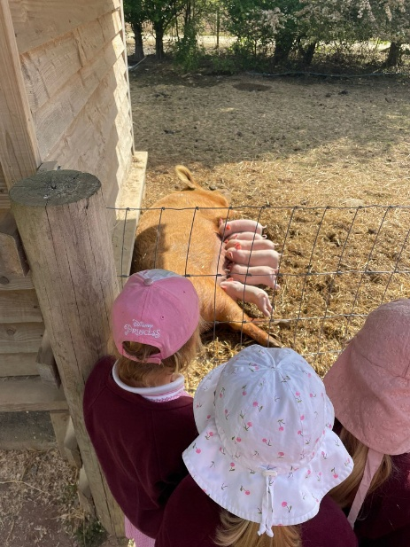
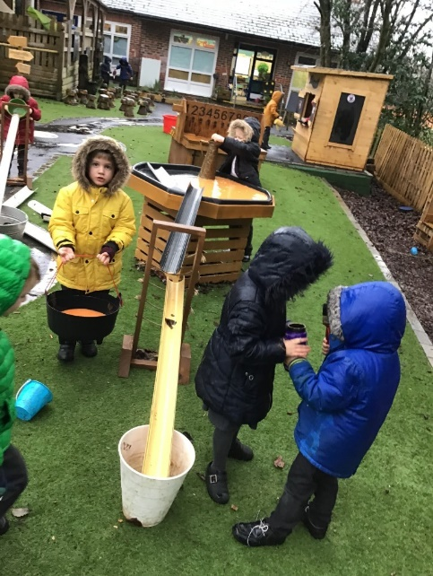
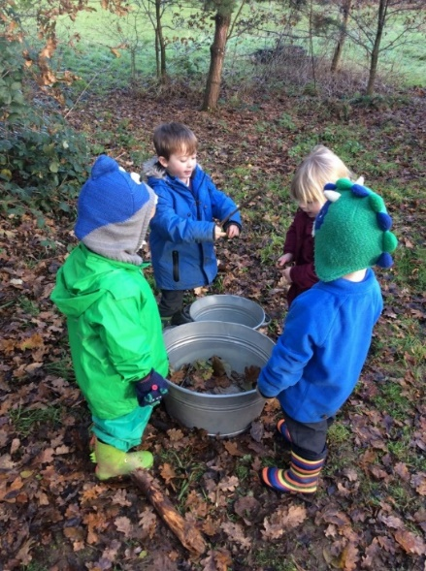
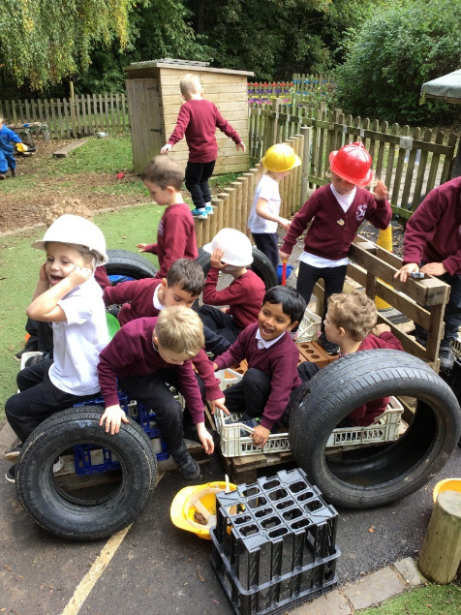
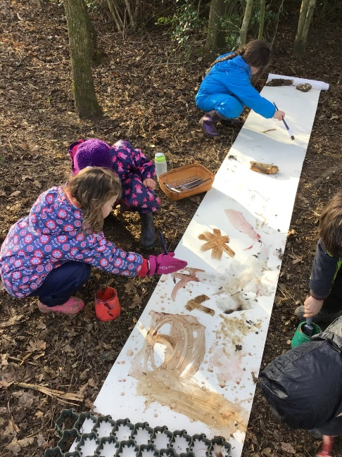
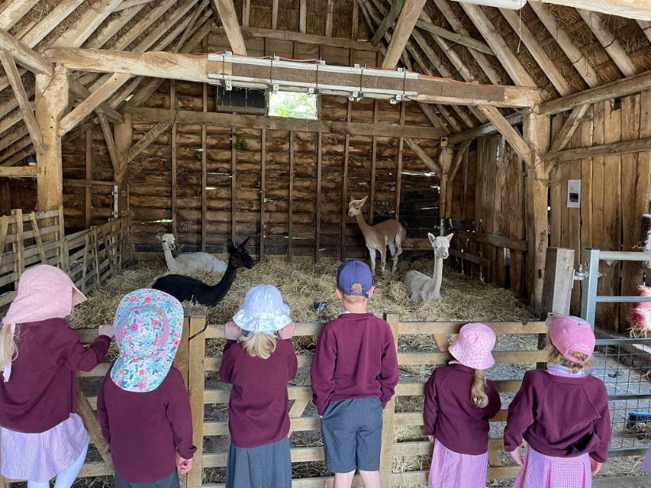
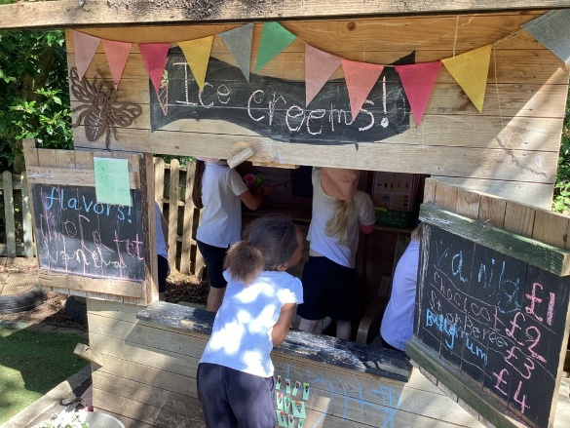
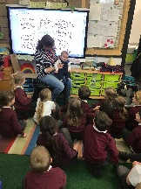
Some examples of our interest-led learning
Notes:
Esther
We follow children’s interests and experiences wherever they take us! We believe that learning is far more effective when children have a personal involvement. We empower them to make choices about their learning and support them to weave in key skills. My class this year were massively interested in owls- an interest we dived into for a good 4 or 5 weeks! This isn’t something we did last year- it can be different every year depending on the children.

Slide 5
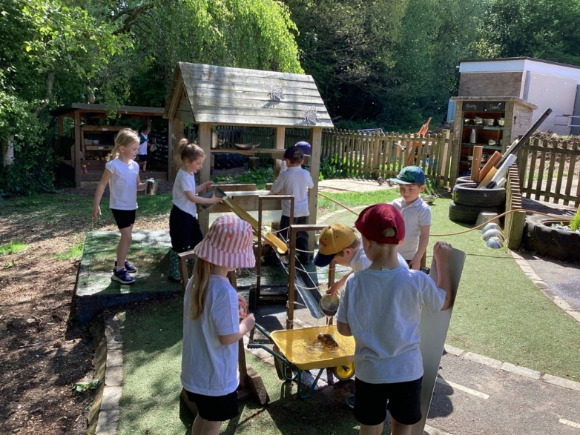
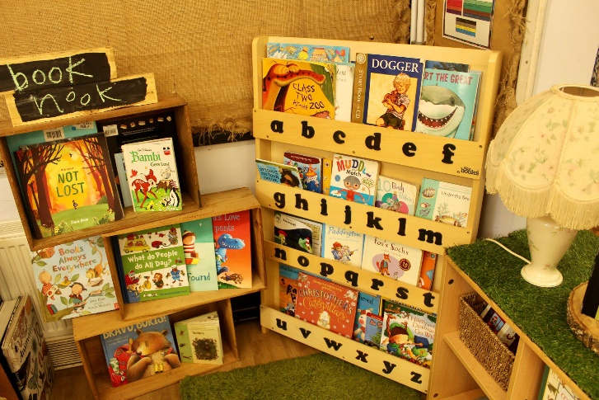
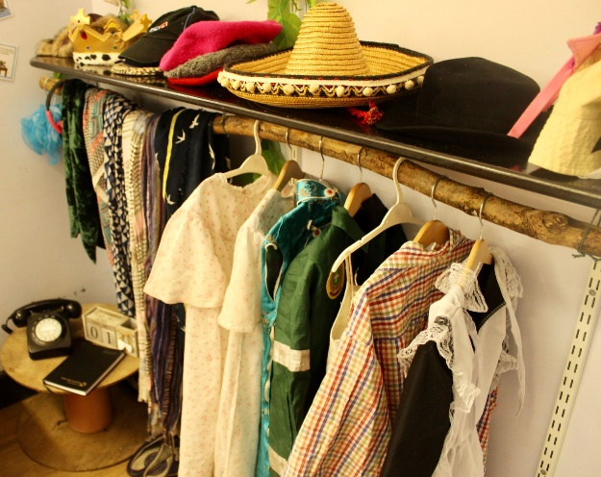
Learning Spaces
Personalised learning spaces so that the children feel a sense of ownership over their classroom, filled with meaningful pictures and objects.
Neutral and not over stimulating.
Authentic resources that spark curiosity!
Extensive outdoor space which is accessed year round.
Notes:
Esther
We design our classrooms specifically for children and not for adults. This sounds very obvious but is actually more complex than you would think! Everything in our classrooms and outdoors is there for a reason.
We believe our children’s learning space should be as personalised to them as possible. You will notice that each child has a space on the wall with a family photo/s. They also have their picture on the class alphabet. These are up before they start school so that on that first daunting day they have some ownership of their space already and the family photo has proved to be very comforting for some.
We are careful about the resources we have in our classrooms- we try and make sure they are open ended, which encourages children to use their imagination and curiosity!

Slide 6
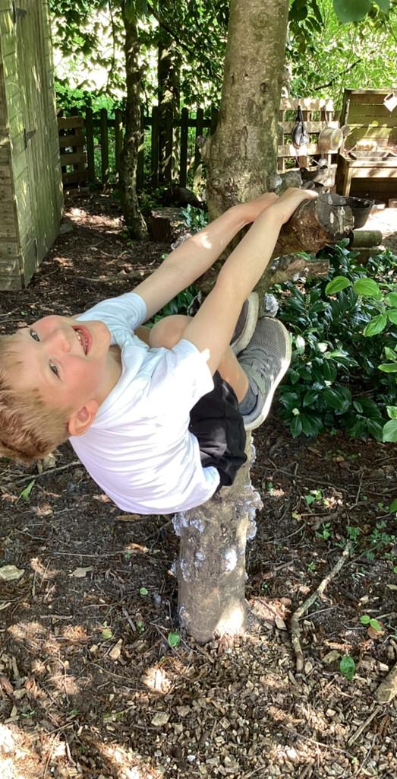
Forest School
Mrs Meager is a Level 3 Forest School leader, trained with the Hampshire and Isle of Wight Wildlife trust.
Forest School allows children to explore nature and learn basic skills such as simple tool use and cooking over a fire.
Our children will be having Forest School sessions in all weathers!
Please ensure your child brings a forest school kit to school with a puddle suit and wellies. When it gets cold we may ask for children to also have thick socks/hats. We have plenty of spares- so please do not feel the need to buy a lot of new stuff!
More info is available at: www.forestschoolassociation.org/
Notes:
Esther
Miss Andrews is a Level 3 Forest School leader, trained with the Hampshire and Isle of Wight Wildlife trust.
Forest School allows children to explore nature and learn basic skills such as simple tool use and cooking over a fire.
Our children will be having Forest School sessions in all weathers!
Please ensure your child brings a forest school kit to school with a puddle suit and wellies. When it gets cold we may ask for children to also have thick socks/hats. We have plenty of spares- so please do not feel the need to buy a lot of new stuff!

Slide 7
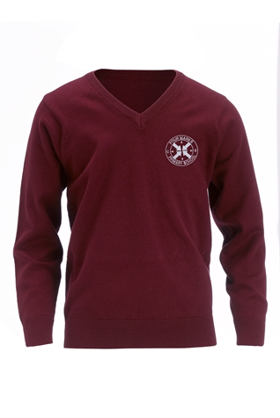
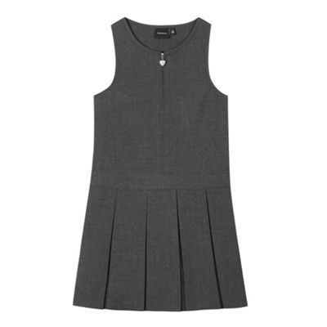

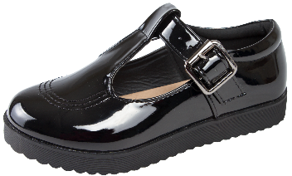
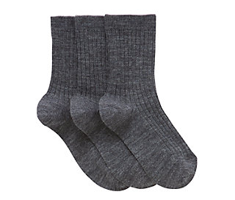

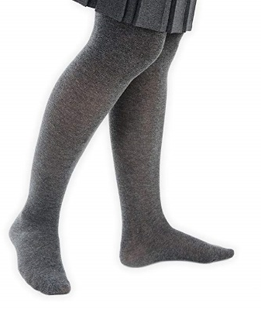
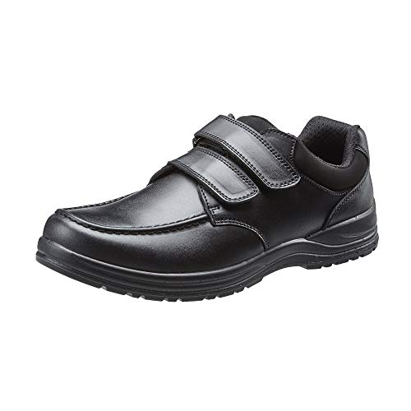
Uniform
Winter Uniform
Notes:
Gem
Polo shirt (available with the logo- but it doesn’t have to have one!)
Grey trousers
Grey socks and black school shoes
A maroon school jumper (available with the logo again- info is in the packs!)
Or
Polo shirt with grey pinafore dress, grey tights and a maroon cardigan.
Durable and study school shoes!
Obviously they will need a warm coat in winter as they spend a lot of time outside. They will also need hats, scarves and gloves when it gets really cold.

Slide 8
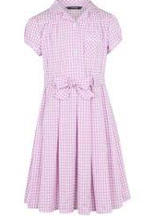


Uniform
Summer Uniform
Notes:
Gem
In the summer children can wear a white polo shirt with grey shorts, or a pink chequered summer dress. When it gets very hot they will also need sunhats and possibly sun cream. FMPS logo sun caps are available, or they can bring in their own- but do ensure it is named.

Slide 9
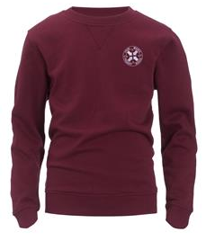
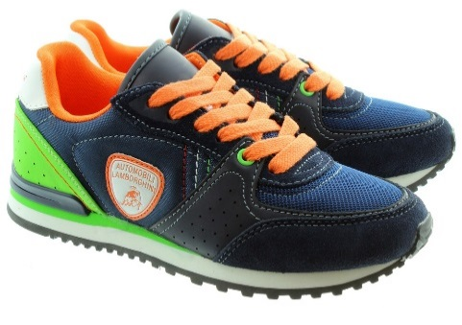
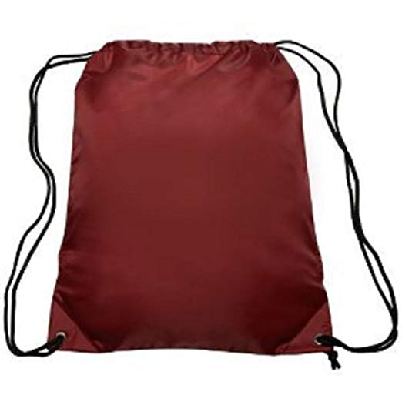

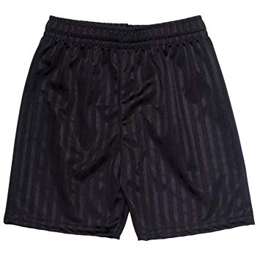
Uniform
P.E Kit
Notes:
katharine
Children have P.E. lessons twice weekly. One of these is a session lead by professional sports coaches.
They will need to have a P.E. kit in school containing:
A white polo shirt
Black shorts
A P.E jumper (logos are available)
Jogging bottoms (for when it is cold)
Trainers (they tend to last better than plimsolls)
From the first week the children will be changing by themselves as much as possible (although we will of course be around to help and support them). Changing in and out of school uniform and P.E. kit etc would be a brilliant thing to practice during the summer.
As I’m sure you can appreciate, it can be a bit of a mess when 20 children change clothes in the same room! Especially when they are all wearing the same uniform! For that reason it is ESSENTIAL that everything that comes into school with your child is clearly named. I would recommend iron on or sewn on labels, as names written in with pen are often totally illegible by Christmas!

Slide 10
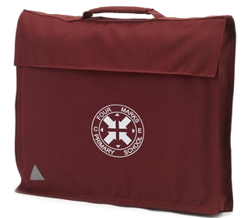
Book bags
Our PTA (parent- teacher association) kindly fund the book bags for the children, so you do not need to buy one.
We will bring your child their book bag on the home visit.
Like everything, it will need to be named and will need to be in school every day.
You will also be given a reading log which will be transported between home and school.
Notes:
Gem
Bookbags have been kindly funded by our PTA, so you do not need to buy one. We will bring the book bags to the home visit in September. The children need to bring their reading book and red reading record to school every day in their book bag. Parents and teachers will write in these and record how many ‘reads’ a child has done in a year- these can be books they read or someone else reads to them.
Children need to bring their book bags and water bottles to school every day.

Slide 11

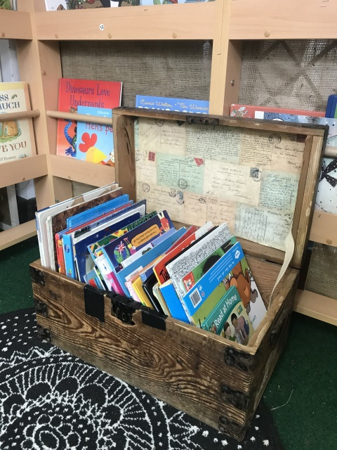
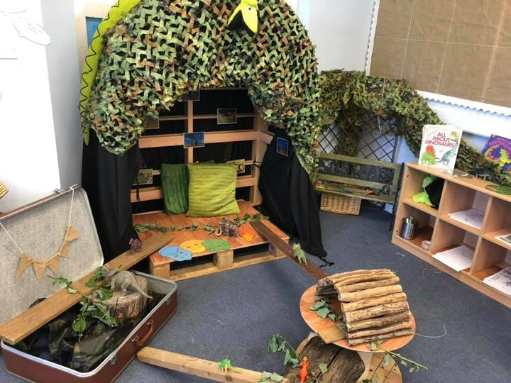
Our School Day
8:45-9:00 | Welcome and Registration
9:00-9:15 | Phonics
9:15-10:45 | Curiosity Time
10:45-11:00 | Whizzy Maths
11:00-11:45 | Curiosity Time
11:45-1:00 | Lunch time
1:00-1:20 | Registration and Wonder Writing
1:20-3:00 | Curiosity Time
3:00-3:15 | Story and Home time
Notes:
Gem
This is an example of a typical school day in the first term. As the year progresses, the children will have longer sessions of maths and phonics, and being to partake in different lessons such as drama, dance and R.E. There will also be some days when they will have P.E with the sports coaches, or Forest School.
You will bring children to our Year R garden in the mornings, and we will open the classroom doors at 8:45 am. Home time will be at the bottom playground.
The children have large chunks of curiosity time. These sessions are when we will put out exciting activities for the children, and they are allowed to freely choose where they go in the environment (inside and out) and play with the resources we have available. We use this time to play with them, get to know them, and take observations of them learning through play. We upload these onto tapestry, an online learning journal. When the children start school we will set them up with a Tapestry account and you will be able to download the app and see what they’ve been up to at school.

Slide 12
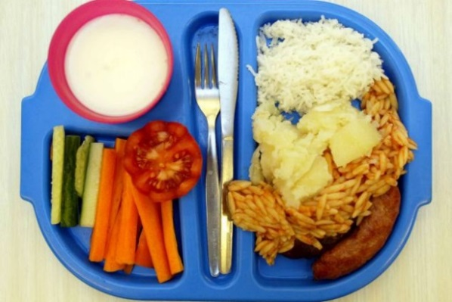
School Lunches
All children in Year R and Key Stage 1 are entitled to free school meals.
The lunch menu is on a three weekly rota.
There is always a vegetarian option and puddings.
Children choose what they would like during morning registration.
Dietary requirements are catered for
Fruit is provided as a snack throughout the day
Children can bring in a named water bottle
Notes:
Gem
School lunches are free for all children in reception.
The menu works on a 3 week rota and there is always a vegetarian option. Children order lunches in the morning so they always get something they like. Children also have choice of salads items and puddings.
If children have dietary requirements Gillian can accommodate for these. You will need to do a healthcare plan for any allergies.
Children can bring in a lunch box from home if preferred. We don’t allow them to have sweets or fizzy drinks in these. They don’t need a huge amount of food- a guideline would be how much they can eat in around 20 mins. There are some ideas for healthy lunchbox ideas on our school website.
We have snack time at school where children have a selection of fruit to choose from and the option of milk. Children can bring a NAMED water bottle into school, which they can drink throughout the day.
In line with our healthy schools policy we do not allow children to bring in bags of sweets for all the children in their class on birthdays. Each class has a special birthday box and when it’s someone’s birthday that child gets a treat just for them.

Slide 13

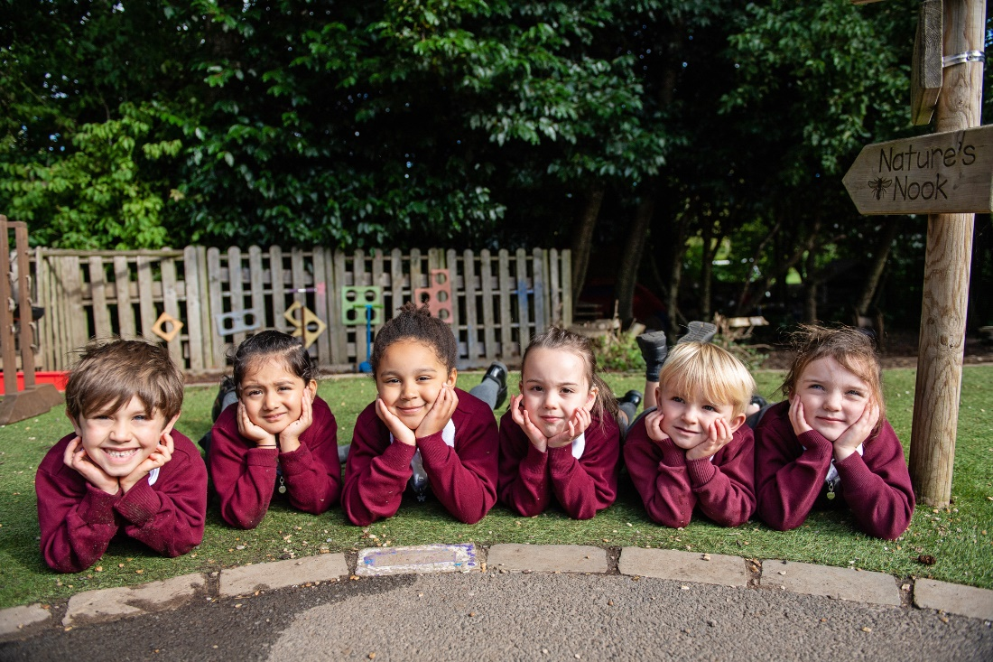
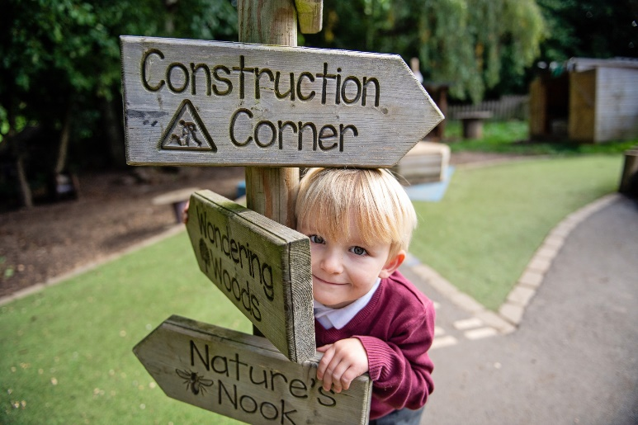
Getting Ready for School
Notes:
Esther

Slide 14

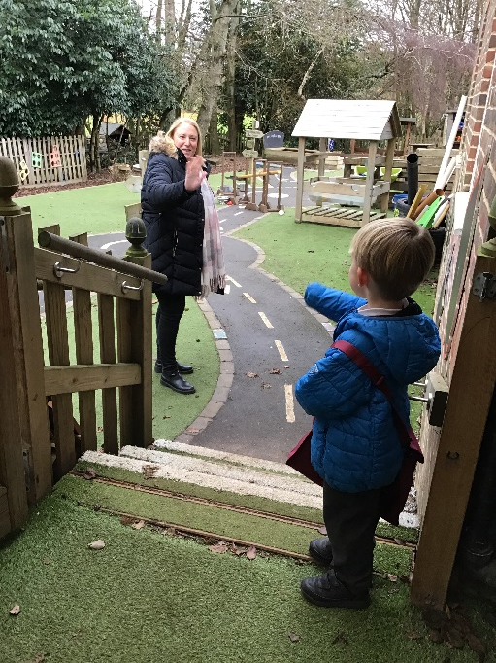
Independence
Saying goodbye routine. Where possible, encourage children to develop a secure and consistent routine at drop off time, supporting them to go into school as independently as possible.
Notes:
Esther

Slide 15
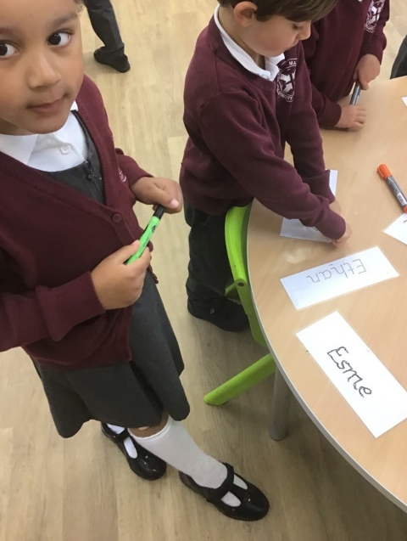
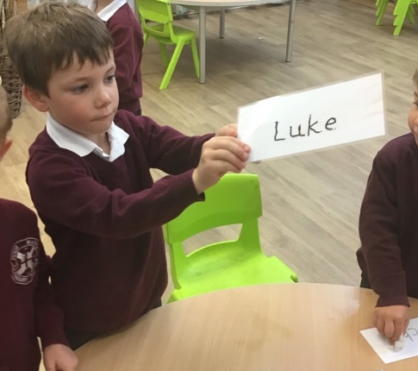
Independence
Recognising your name
If children can begin to recognise their own first name, this will allow them to more easily identify their own peg, jumper, book bag etc.
Notes:
Esther

Slide 16
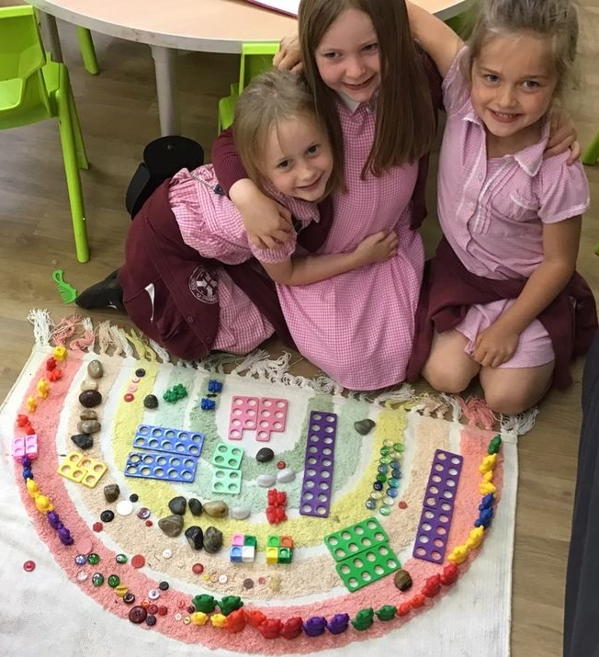
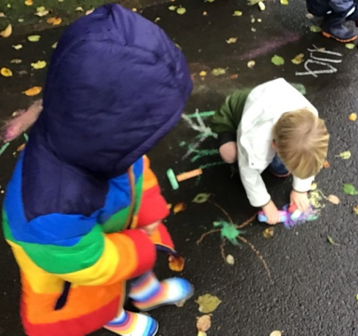
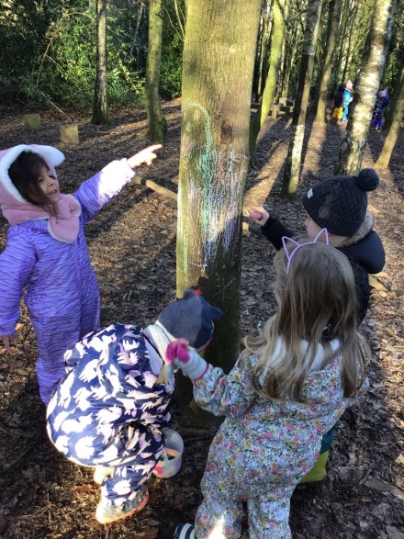
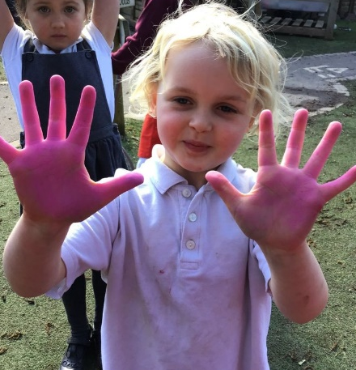
Independence
Learning your colours
Recognising the main colours and naming them will allow children to more independently select materials and resources they need to create and draw.
Notes:
Esther

Slide 17
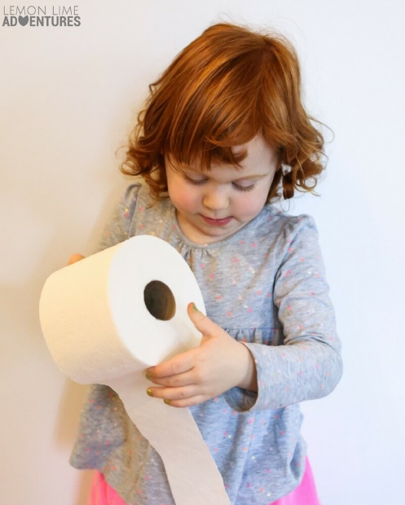
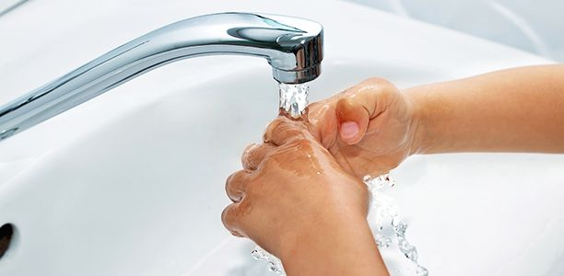
Independence
Going to the toilet
Ideally, children should be able to recognise when they need the toilet, wipe themselves, flush and wash their hands properly. If they have an accident, they need to be able to tell an adult.
Notes:
Esther

Slide 18
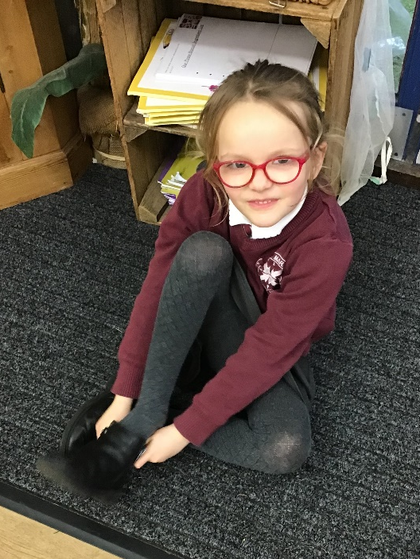
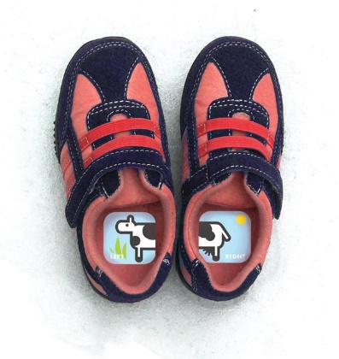
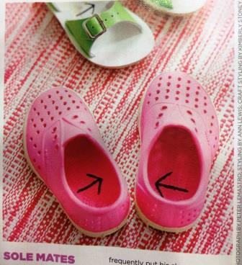
Independence
Shoes
Children should be able to take off and put on their shoes with minimal support. Stickers and arrows written inside can help children to ensure they get shoes onto the correct foot. Shoes without laces enable children to be more independent in reception.
Notes:
Gem

Slide 19
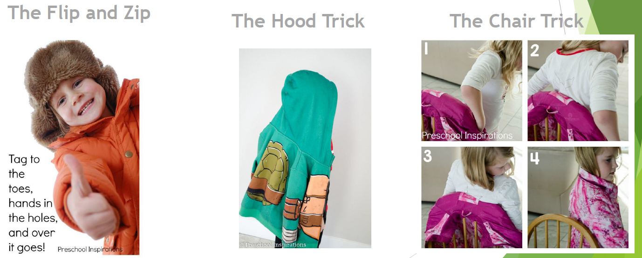
Independence
Getting coats on and off
Notes:
Gem

Slide 20
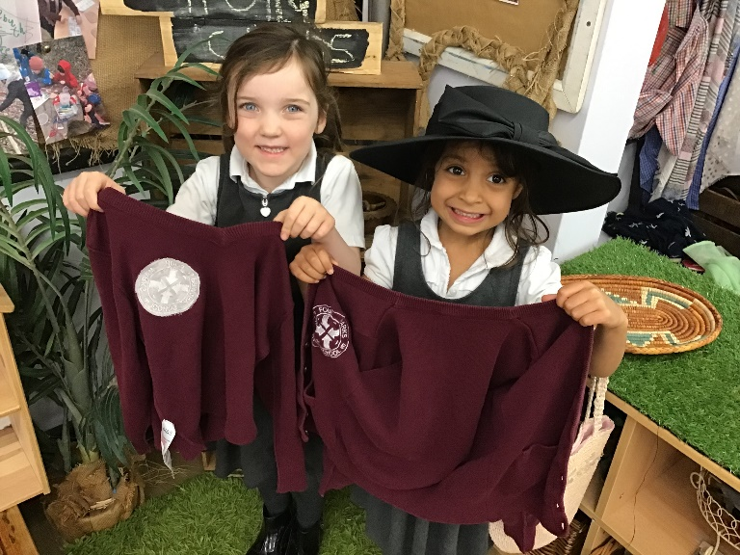
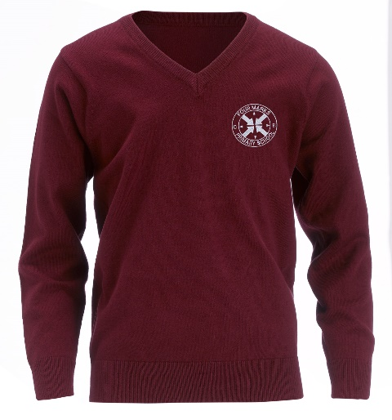
Independence
Looking after my own jumper
Children should be encouraged to recognise their own name sticker/stamp so that they can find their jumper. They will be encouraged at school to ensure it is put in the jumper dumper if they want to take it off so that it doesn’t get lost.
Notes:
Gem

Slide 21
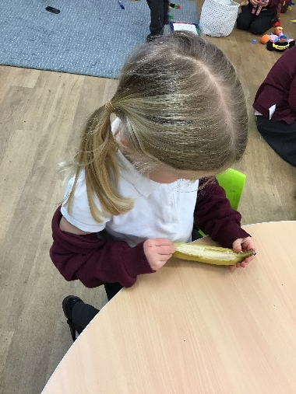

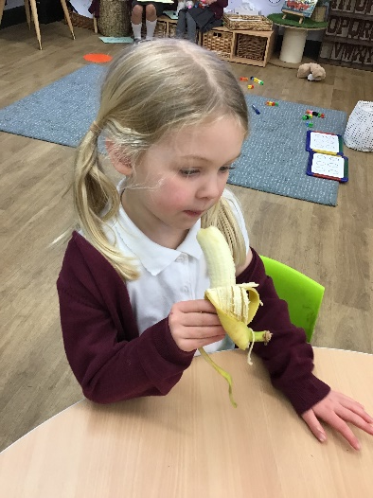
Independence
Snack time
Encourage children to peel oranges, bananas and open small packets as they will be doing this at school.
Notes:
Gem

Slide 22


Independence
Drinking Water
Encourage children to recognise their own water bottle (please name these) and to take a drink when they are thirsty. Bottles that children can easily undo are ideal in reception.
Notes:
Gem

Slide 23



Independence
Eating Lunch
Support children to use a knife and fork, and to cut up their food (there will be older children acting as table hosts to support them with this).
Notes:
Gem

Slide 24




Socially Ready?
A socially ready child will be confident to play with other children and build relationships with people outside of their family. You can support them by arranging play dates over the summer.
Notes:
Gem

Slide 25




Physically Ready?
You can support your child’s physical development by encouraging them to build their gross motor (climbing, running, jumping) and fine motor (pencil control, threading, lego) skills.
Notes:
Gem

Slide 26



Language Ready
You can support your child’s early language development by talking with them, explaining and using new vocabulary, exploring a range of exciting books, singing songs and nursery rhymes and encouraging them to talk in full sentences.
Notes:
Gem

Slide 27

Home-School Communication
Appointments
Email school office/teacher directly
Telephone – 01962 772200
Email service from school office
Please ensure school has your up to date contact details
Paperless school – check newsletter on website for regular dates
Please request to join our Facebook Page:
Four Marks Primary School Reception 2026-27
Notes:
Esther
In early years, we view our children in a holistic manner, which means it is important to know what’s going on in all aspects of their lives. Please always feel free to come and chat to us about anything. We are always on the door in the mornings and at the end of the day, or you can set up a more formal appointment should you need to.
Our facebook group is for us to quickly share any school updates, such as if we have put letters in book bags. It’s also for you to post questions for us and other parents to see, or if jumpers etc have gone missing. We email out important messages as well for those not on facebook- this is just an additional method of communication we have continued since Covid.

Slide 28
Dates for your diary
TRANSITION
Wednesday 1st June 10:45-11:30 | Stay and play session for children and parents
Wednesday 10th June 10:45-11:30 | Stay and play session for children and parents
Wednesday 24th June 10:45-11:30 | Stay and play session for children only
Wednesday 1st July 10:45-11:30 | Stay and play session for children only
Wednesday 1st July 10:45-11:30 | Parent coffee morning (while children are in their session)
Notes:
Esther

Slide 29
Dates for your diary
 | STARTING SCHOOL
Thursday 3rd September Friday 4th September Monday 7th September | Home Visits Please let us know what dates you are not able to make. We will then email you a time and date.
Tuesday 8th September Wednesday 9th September Thursday 10th September | Half day at school- 9:00 – 11:30
Friday 11th September | First full day at school! ☺

Slide 30


See you in September!
We can’t wait to have your little ones join our school. We have worked hard to create an environment where children can flourish, supported by our caring and knowledgeable team, and will continue to work hard to ensure they feel happy and safe here with us at Four Marks.
Here is what our children have to say!
https://four-marks-church-of-england-primary-school.primarysite.media/media/a-day-in-the-life-of-year-r
Notes:
Esther
A big thank you for choosing our school.
My connection to FM
Ofsted outstanding
Hampshire Education awards
LFSP

